Slide 1
Functional Modelling

Slide 2
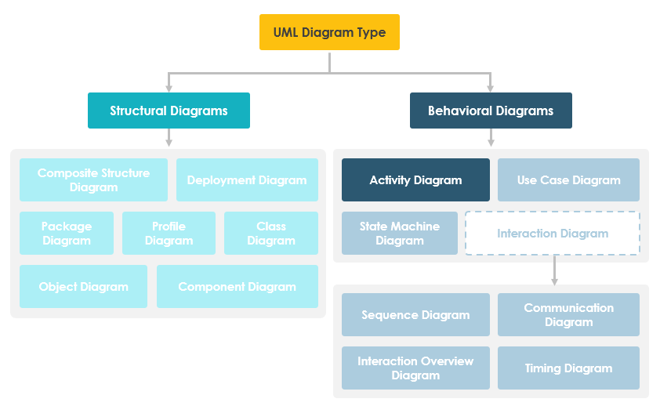
UML Diagram Types
Visual Paradigm, 2022

Slide 3
Activity Diagrams
Behavioral
  Low level view
  Models logical flow of the system
  Describe the steps in UML use case
  Simplify and improve process in use case
  Model software architecture elements
  Similar to Flow charts/Data Flow Diagrams

Slide 4
Components of activity diagram
Action – a step where action is performed by the user or software
Decision node – conditional branch with two of more branch
Control flows – Connectors between steps
Start node - Starting point of an activity
End node – final step of of the activity

Slide 5
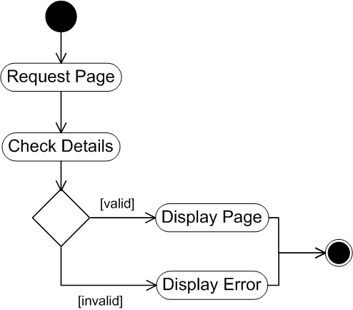
Activity Diagram
Start node
Connector
Action
Decision
End node

Slide 6
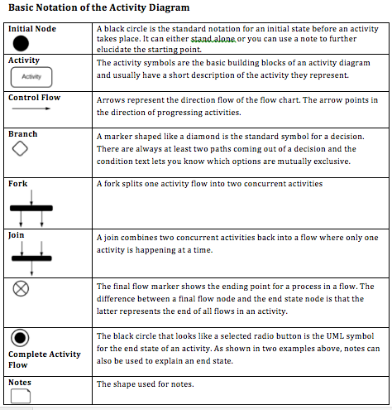
Activity Diagram Symbols

Slide 7
Activity Diagram – Borrowing A Book
Activity
Borrower Selects Book
Initial node – the beginning
Borrower Confirms Selection
Loan Requests Borrower ID
Branch (Condition)
Not OK
Transaction Cancelled
OK
Book sent to Borrower
Loan Records Book ID
Final node – the end of the activities

Slide 8
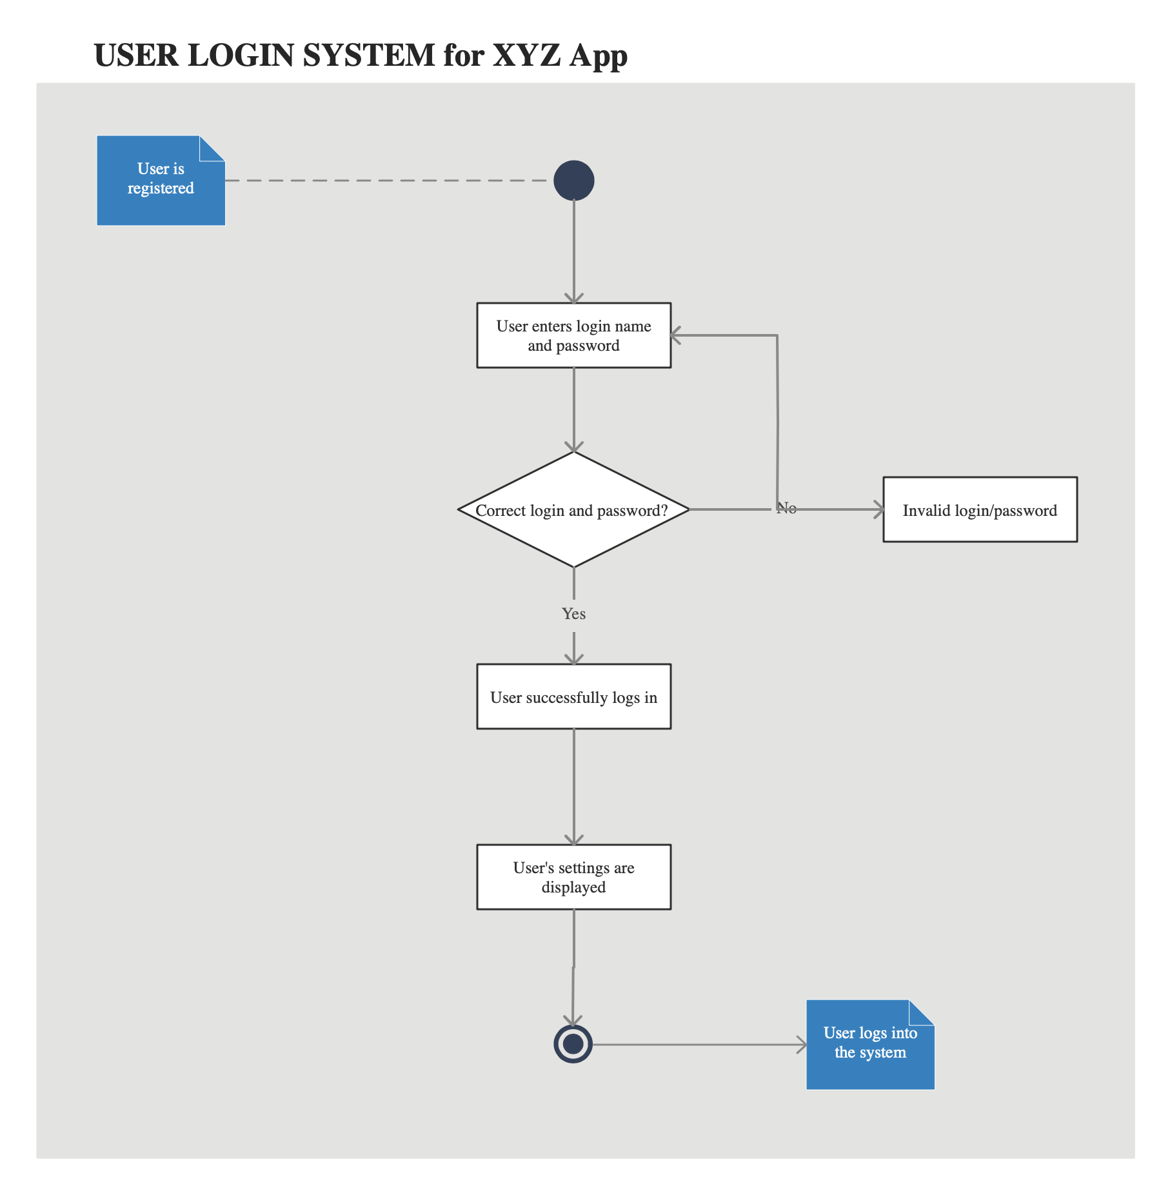
Activity Diagram – User Login

Slide 9
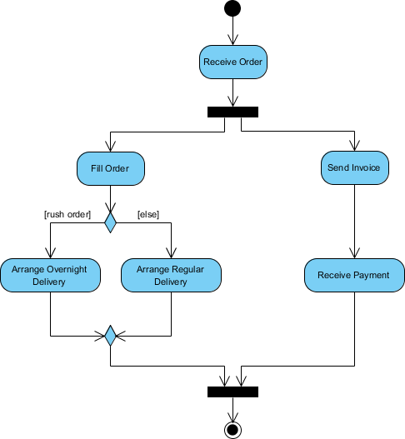
Activity Diagram Order Processing
Forks – where one activity splits into two concurrent activities
Join – combines two concurrent activities back into the flow where only one activity is happening at a time
Fork
Order Processing Description:
Once the order is received, the activities split into two parallel sets of activities. One side fills and sends the order while the other handles the billing.
On the Fill Order side, the method of delivery is decided conditionally. Depending on the condition either the Overnight Delivery activity or the Regular Delivery activity is performed.
Finally the parallel activities combine to close the order.
Join
Visual Paradigm, 2022

Slide 10
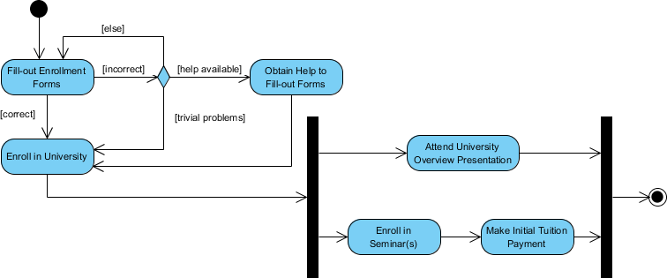
Activity Diagram - Student Enrolment
An applicant wants to enroll in the university.
The applicant hands a filled out copy of Enrollment Form.
The registrar inspects the forms.
The registrar determines that the forms have been filled out properly.
The registrar informs student to attend in university overview presentation.
The registrar helps the student to enroll in seminars
The registrar asks the student to pay for the initial tuition.
Visual Paradigm, 2022

Slide 11
Environmental Control System

Slide 12
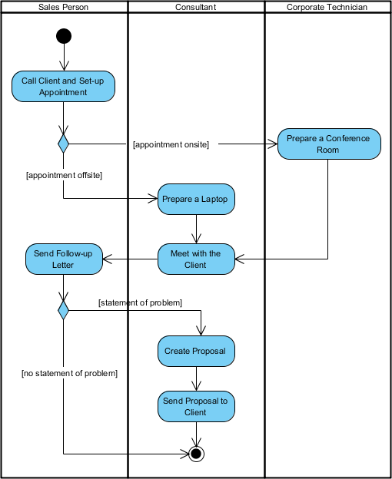
Swimlane
Process is show from start to finish and
Who is responsible for each step
Visual Paradigm, 2022

Slide 13
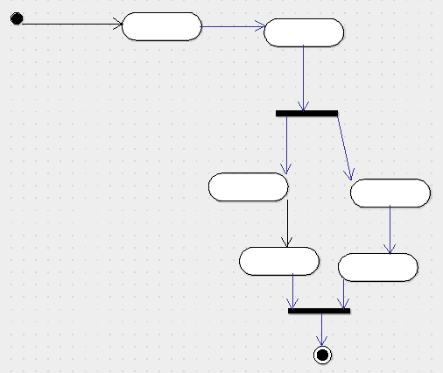
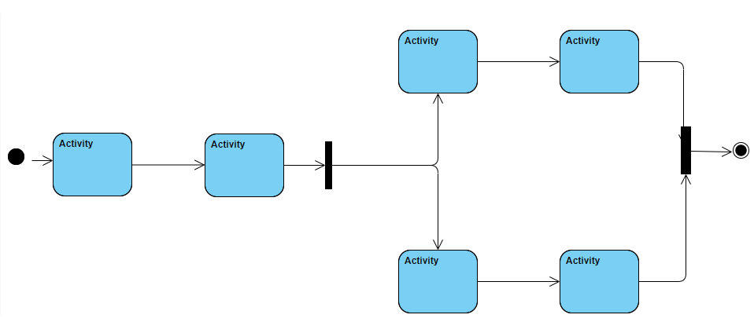
UML Software Differences
Visual Paradigm
Uses horizontal representation for joins and forks
Swim lanes can be flipped vertical/horizontal
ArgoUML
Uses vertical representation for joins and forks
Swim lanes only vertical

Slide 14
Tasks
Complete the Activity Diagram Tasks
Use the remaining time for your assignment

